Slide 1

CSP/ISV Digital Health Town Hall Event-in-a-box

Slide 2
2
Digital Health Town Hall Event-in-a-box:
Guidance package for hosting a local event.
Contents
Purpose / Strategy
Town Hall approach
Panelist identification
Venue selection guidance
Content creation and distribution plan
Considerations / Learnings
Getting started
Global Town Hall Calendar & Links

Slide 3
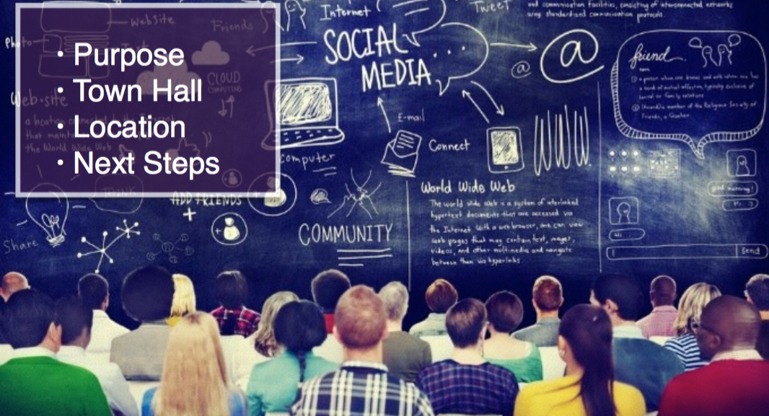
2
CSP/ISV Event Strategy
Purpose
Our mission: To change opinion of IBM and drive relevance by actively demonstrating how we will connect and build a future with them. We must place CSPs/ISVs and their needs at the center of our universe.
By carefully crafting relationships with external influencers and bringing them together with IBM SME’s, we can drive conversation and collaboration that moves the dial and shows them we aren’t the typical Big Blue they think we are.
Town Hall Approach
WHAT: Ongoing influencer led “town-hall” conversations covering industry focused topics of interest.
CADENCE: Approximately once a month. Announce via POE upcoming speaker and topic, providing link to a registration page.
WHO: Sessions will initially be led by IBM industry-focused SMEs, evolving to include CSP/ISV customers. Pilot with CSP/ISV Biz Dev prospects and customers as attendees, consider extending to broader CSP/ISV community based on performance.
TOPICS: Sessions will align to industry and CSP/ISV areas of interest sourced from 1) survey of CSPs/ ISVs; 2) research results (IDC, Forrester); 3) sales team insights.
CHANNELS: Events will execute in a variety of formats to test for best options, e.g. Tweet Chat, Google Hangout, physical meet-up + digital component, physical meet-up alone, etc. Attendees will be encouraged to share and engage with others via social during event.
AMPLIFY CONTENT: Content from the event will be made available for use globally:
Events will be recorded and archived on the portal. Social media surround assets will be created to help drive traffic to CSP portal and replay content.

Slide 4
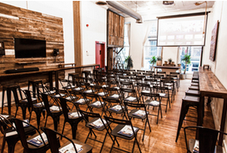
2
CSP/ISV Event Strategy
Panelist Selection
By carefully crafting relationships with external influencers and bringing them together with IBM SME’s, we can drive conversation and collaboration that moves the dial and shows them we aren’t the typical Big Blue they think we are.
Criteria:
Social Savvy
Active daily
Authentic engagement with community
10,000 + followers/fans
Strong content creation
Multi-platform
Positive opinion or relationship with IBM
Start-ups and Leaders within their area of expertise
Selecting Venue
Select incubator type / co-working venues with open space and natural lighting. Select locations to accommodate 30-40 individuals with area for panel, audience seating and stand-up reception area.
Consider working with industry groups to leverage their membership lists.
Consider livestreaming event to increase audience reach.
Example: The Farm, Soho in New York City

Slide 5
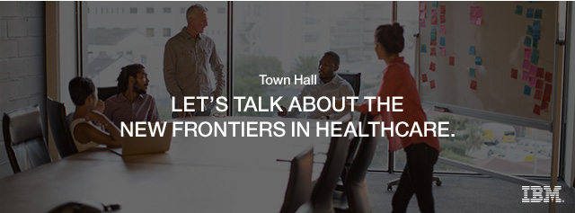
2
Digital Health Town Hall (July 21)
Topic: Transformative trends and technologies affecting healthcare
Location: Incubator Venue- The Farm in SoHo
Attendance Goal: 25-30 Influencers, Prospects, Customers
Opportunities to Scale: Digital Content created at the event; IOT guidance to run local event
Moderator: Steve Lohr, Reporter, New York Times
Panelists:
We’re excited to invite you, and a select number of your peers, to attend the first of our series of Town Hall events. This panel discussion will be focused on healthcare and hosted by New York Times tech reporter Steve Lohr. We’ve assembled a panel of digital health experts to discuss the new opportunities and challenges created by the crossroads of technology and data in the healthcare industry. Town Hall Thursday, July 21, 2016 5:00 pm – 7:00 pm The Farm SoHo 447 Broadway New York, NY 10013 Refreshments will be served.
Lisa Hammitt
VP, Cloud Mktg
Seth Norman
CIO, Tiatros
Gil Addo
Founder,
Rubicon MD
Unity Stoakes
Co-founder,
Start-Up Health
Paul Testa
Chief Medical Info. Officer,
NYU Langone Health System

Slide 6
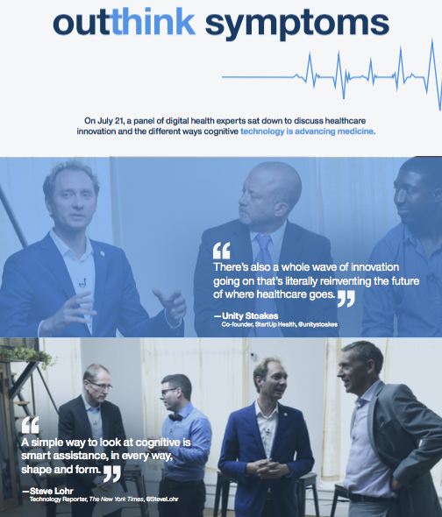
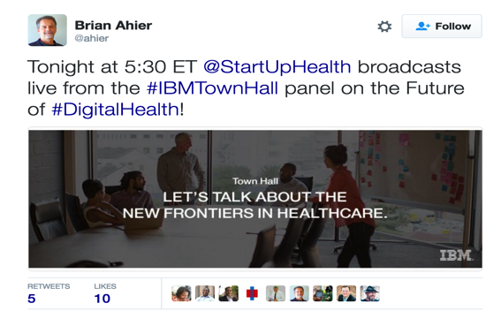
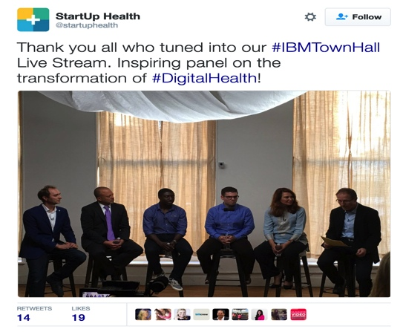
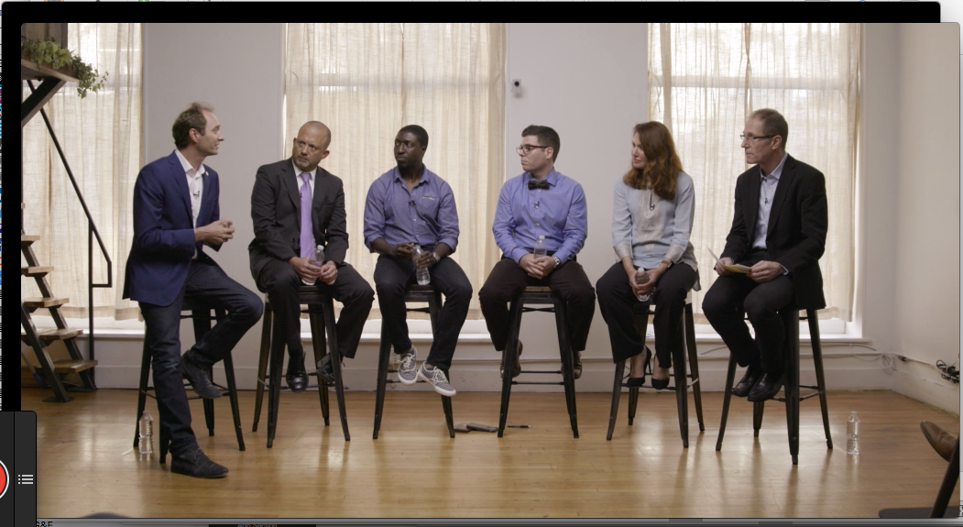

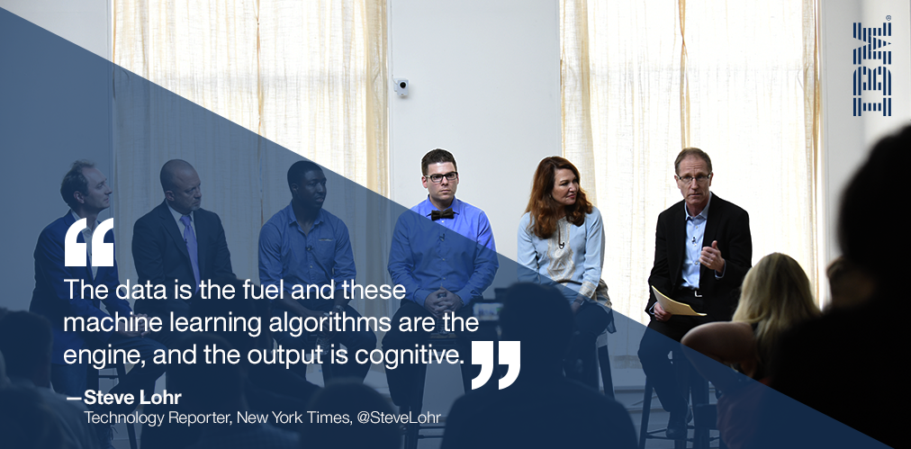
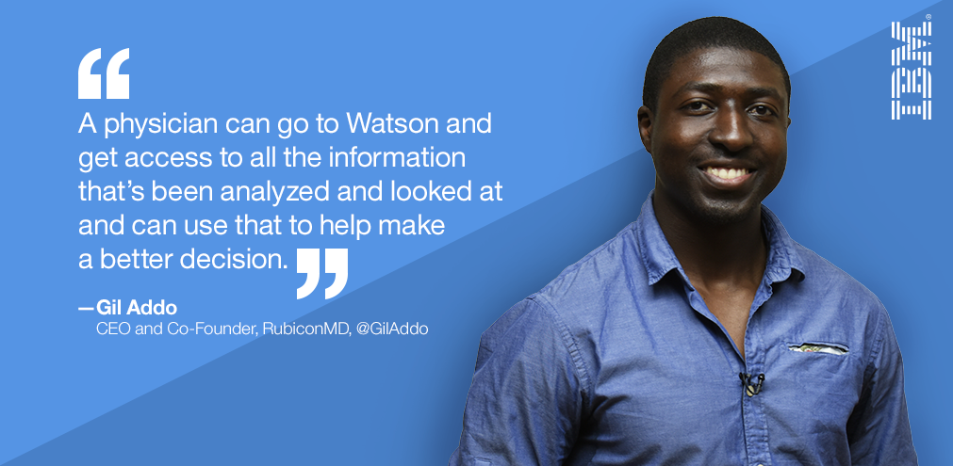
Digital Health Town Hall Content and Distribution Plan
Pre-event
Influencer / panel questionnaire
Invitation
Drive to: social tiles / tweet content
Influencer social amplification
Post-event
Video replay / long form / short clips / transcript
Individual interview videos
Infographic
IBM social amplification tiles & tweets
Distribution Plan
Leverage Global list of Industry SMEs
Leverage IBM BU social media channels
Leverage Influencers’ reach
Infographic
Influencer Promotion
Long form video replay
LINK TO THIS CONTENT
IBM social amplification

Slide 7
Digital Health Town Hall Distribution Plan
HEALTHCARE INFLUENCERS LIST | NAMES
Healthcare Forward Thinkers – External to IBM | RubiconMD ‏@Rubicon_MD , StartUp Health ‏@startuphealth , JOHN NOSTA ‏@JohnNosta , HealthIT Policy ‏@HITpol , Brian Ahier ‏@ahier
IBM Healthcare Social Team | Sumeet Kad/India/IBM, Adriana Garjoaba/Romania/Contr/IBM,
IBM Watson Social Team | Heather Adamson/Piscataway/IBM@IBMUS, Keith Kaplan/Armonk/IBM@IBMUS
Internal IBM Influencers / Watson SMEs | Watson: Jacqueline Gallus/New York/IBM@IBMUS, Arthur Lewandowski/Mount Laurel/IBM@IBMUS, Thomas H Davis/Somers/IBM@IBMUS
External Influencers | Racepoint: Lewis Forman <lforman@racepointglobal.com>
Watson Social Media Channels | https://twitter.com/ibmwatsonhealth https://www.linkedin.com/company/ibmwatsonhealth
Geo Marketing and Digital Sellers | Dave Mitchell/Somers/IBM, Gina Gutierrez/Armonk/IBM, Petra Bernhardt/Germany/IBM, Sandra B Hulvat/Philadelphia/IBM, Caroline Tan/Rolling Meadows/IBM,
CSP Portal Industry Expert | Healthcare: Todd Kalyniuk, kalyniuk@ca.ibm.com , twitter: @ToddKalyniuk
CSP LDRs | Mojy Asgari/Dallas/IBM@IBMUS, Jenny Ng/Ontario/IBM@IBMCA,
IBM PartnerWorld Digital Channel and Communications Tools | CCDB Content Creator Database John Wood: John Wood/Toronto/IBM, PW Twitter: Ana Fernatt/Chicago/Contr/IBM
CSP/ISV Weekly Social Digital Tip Sheet | Leigh Barrett: Leigh Barrett/White Plains/Contr/IBM,

Slide 8
Digital Health Town Hall Event Learnings
What worked well | Recommendations
A more targeted industry focus for the town halls will allow IBM to effectively demonstrate their expertise in the specific field vs. taking a general approach to be “everything to everyone” | Continue using industry filter to demonstrate relevant, specialized expertise.
The strong growing interest around cognitive technology is key differentiator for IBM and will continue to drive participation from our potential audience | Constantly engage with IBM Watson or cognitive SMEs with a strong physical and digital presence before, during and after events to drive relationships with the CSP community
Community involvement before, during and after the event is intrinsic to success | 1. Give community “skin-in-the-game” to: Drive collaboration and turn them into promoters Give IBM a credible way into the broader community Provide low-risk environment to test new channels with an established audience Extend reach of the IBM CSP community
Internal and external influencers are excited to engage, but need more lead time to do so on a more personal level | Identify timelines for both IBM + Ogilvy teams for influencer outreach influencers can plan to participate.
In addition, a compelling non-monetary value exchange – e.g. exclusive access to a Watson SME – can drive influencer and community participation | Identify “value-exchange” for respective town halls Confirm IBM SME’s participation for appropriate events
Reach within our social channels is significantly limited without paid support | 1. Invest in paid social media to ensure content breaks algorithmic barriers and reaches our community. 2. Use multiple platforms (via IBM, community collaborators and influencers) with a paid investment to ensure greatest reach and gain learning's around audience
Accelerate momentum of the CSP Program | Develop content distribution plan, including production process to ensure exclusive content reaches influencers and community in a timely manner Keep event cadence no longer than 1 month apart Identify micro-opportunities for interim engagements

Slide 9
Getting started with your own Digital Healthcare Event
Plan to run a local led Digital Healthcare event using Global content package.
Create a project plan to detail out all steps.
Select topic / event format (IBM)
Select and confirm location availability (IBM or Agency)
Confirm panel host and participants availability (IBM or Agency)
Create and finalize pre- and post-event communication plan (IBM & Agency)
Finalize, present, gain approval on influencer strategy (IBM & Agency)
Reach out to sales to confirm prospect and existing customer attendee list (IBM)
Recruit influencers (IBM & Agency)
Create outreach assets, invitations, seed story with influencers (Agency)
Partner with panel host and participants to shape conversation (IBM or Agency)
Consider live streams, on-site social media, video capture (IBM or Agency)
Post-event content management editing (Agency)
Post-event communication strategy (IBM)

Slide 10
CSP/ISV At-a-glance Town Hall Calendar
July / Aug | Sept | Oct | Nov | Dec
New Frontiers in Digital Healthcare | CSP Summit at Edge | CSP Summit at World of Watson | Blockchain for FinTech | Retail
Panel Discussion on trends in Healthcare and impact of Cognitive | Full day event at Edge for CSPs/ISVs | Half day event at WOW for CSPs/ISVs | Fireside chat with Blockchain CTO and a CSP/ISV who has a FinTech Blockchain solution | IBM and industry experts review Black Friday and Cyber Monday data and share insights around consumer shopping behavior
Link to content | Link to content

Slide 11
Funding Considerations
Low $ | Med $$ | High $$$
Digital Online event Social surround | Digital Online event Social / Paid Media Influencer Support | Face-to-face event Venue Rental Panelists / Travel Food & Beverage Drive to creative costs Social / Paid Media Post Production / editing
Google hangouts Twitter events | Google hangouts Twitter events Webcasts 3rd party led events | Moderator led panel discussions Livestream events Fireside chats
Digital Healthcare Town Hall Example
- venue location $1,500 - food and beverage $500 - travel for o/o/tl influencers $2,000 - drive to with paid media $15,000 - $20,000 - content plan post event – OOP video production and editing $25,000 For the July town hall ~$50,000 - speaker costs - we feel we shouldn’t pay speakers or influencers. We feel there are enough people out there that want to align themselves with IBM for their own personal brand that we don’t need to pay to play.

